Slide 1
How to use the SUBSTRING function to separate out part of a column in an Alma analytics report
Yoel Kortick | Sept. 2024

Slide 2
Introduction
Applying the substring function
Creating a graph based on the SUBSTRING function

Slide 3
Introduction

Slide 4
Introduction
There may be cases where the actual text appearing in a report would be more appropriate if only a certain part of it appeared.
For example in the fulfillment subject area there is a field “Loan Date.Loan Time”
It appears as the full time, for example 11:47:05 or 14:54:08
The library may however be interested in getting only the hour, therefore only the first two positions would be desired.

Slide 5
Introduction
In the following situation, for example, the library is interested in knowing which hours the library circulation desks are most active so that they can correctly allocate staff
Thus they have created a report of all loans in 2023 at the “Main Library Default circulation desk” with the amount of loans and the loan time

Slide 6
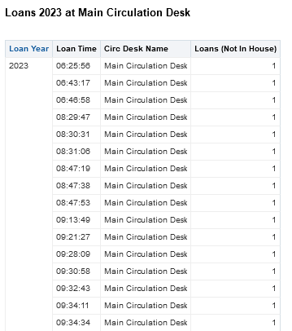
Introduction
Instead of the loan time we want the loan hour. Then for example all loans in one hour will appear together instead of ‘1’ loan for each exact minute.

Slide 7
Applying the substring function

Slide 8

Applying the substring function
If we want the hour from the loan time, then we need to take the first two positions of the time.
Here the hour will be “06”
Here the hour will be “08”

Slide 9
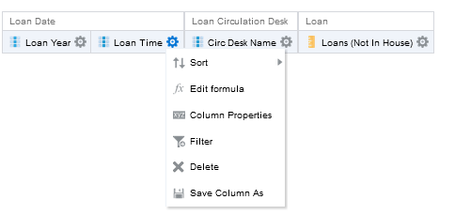
Applying the substring function
In the criteria tab for Loan Time, we choose “edit formula”

Slide 10
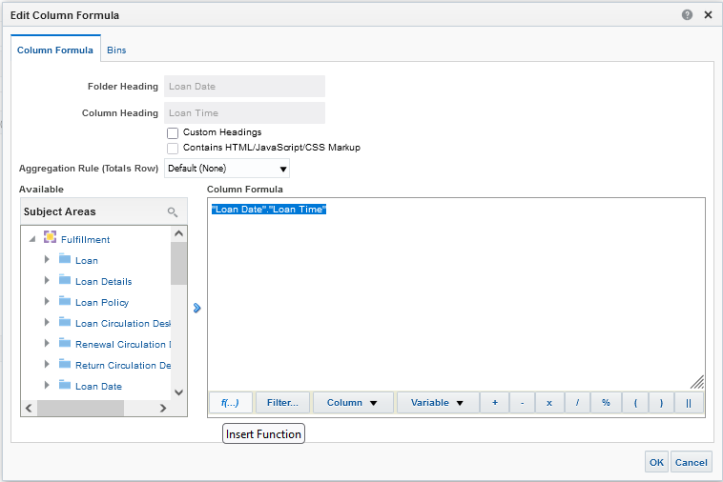
Applying the substring function
Then we will choose “Insert Function”

Slide 11
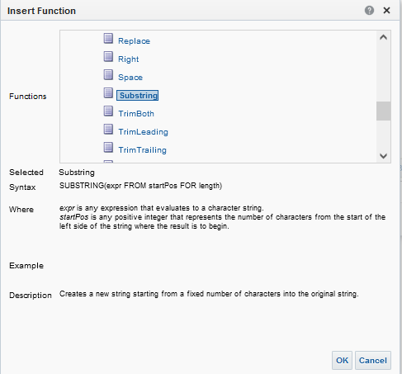
Applying the substring function
Under the “String” section we will choose “Substring”
We can already see an example of what the syntax should be

Slide 12
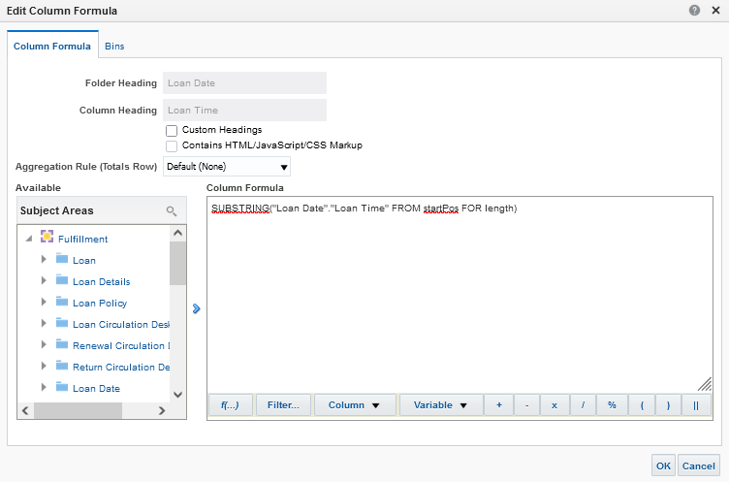
Applying the substring function
Now we see that we have: SUBSTRING("Loan Date"."Loan Time" FROM startPos FOR length)

Slide 13
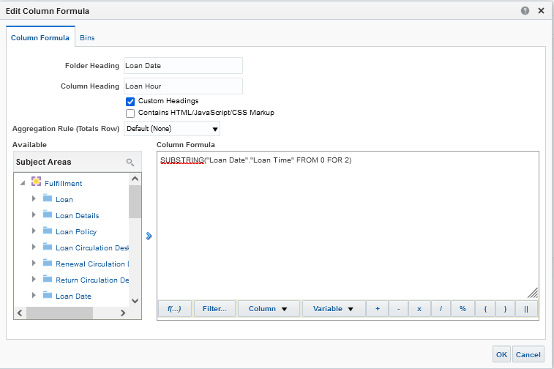
Applying the substring function
Change it to SUBSTRING("Loan Date"."Loan Time" FROM 0 FOR 2)
We also changed the column header from “Loan Time” to “Loan Hour”
SUBSTRING syntax to get the “Loan Hour”

Slide 14
Applying the substring function
The syntax
SUBSTRING("Loan Date"."Loan Time" FROM 0 FOR 2)
means “start at position 0 (the beginning) and take 2 characters”

Slide 15
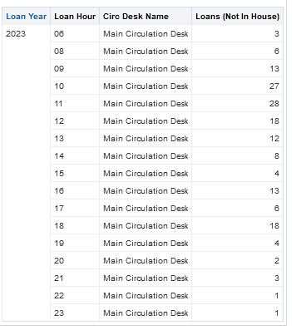
Applying the substring function
Now in the results tab we have the hour instead of the full time.

Slide 16
Creating a graph based on the SUBSTRING function

Slide 17
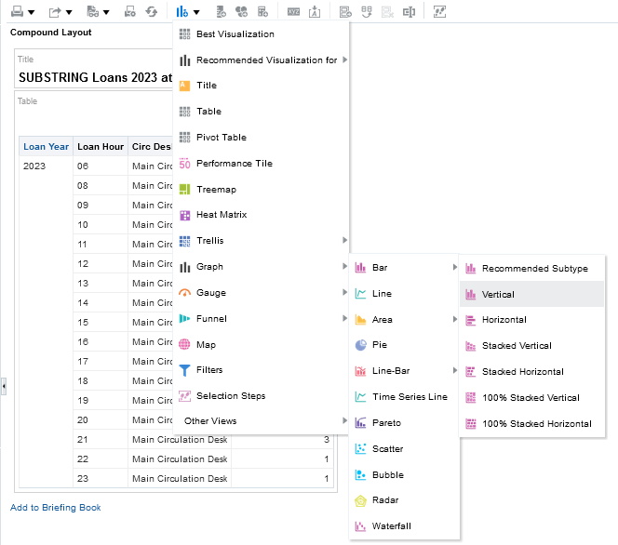
Creating a graph based on the SUBSTRING function
In order to be able to evaluate the loans per hour in a clear visual manner we can add a graph based on the SUBSTRING

Slide 18
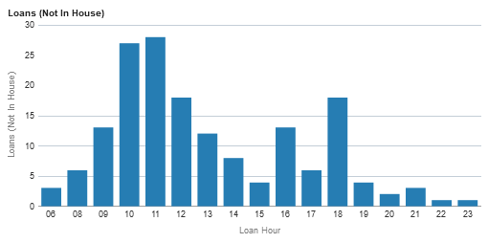
Creating a graph based on the SUBSTRING function
We can immediately see that the peak hours are between 10:00 and 11:00.
Before 09:00 and after 18:00 are very low hours.
This can help in knowing when to allocate staff to the circulation desk.

Slide 19
Thank You.
Yoel Kortick

